Slide 1


kubi
T-CLO-902 MSC 2022 GROUP 13
Notes:
greg

Slide 2
SUMMARY
Introduction
Team
Organization
Project
Feedback
Enhancements
Demonstration
Questions
Notes:
greg

Slide 3

Introduction
Notes:
greg

Slide 4
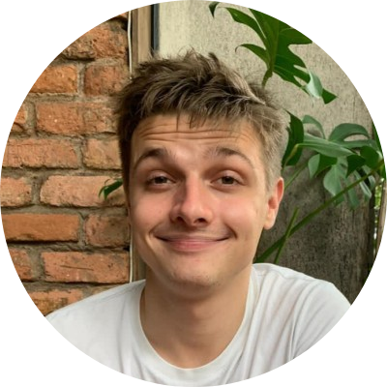
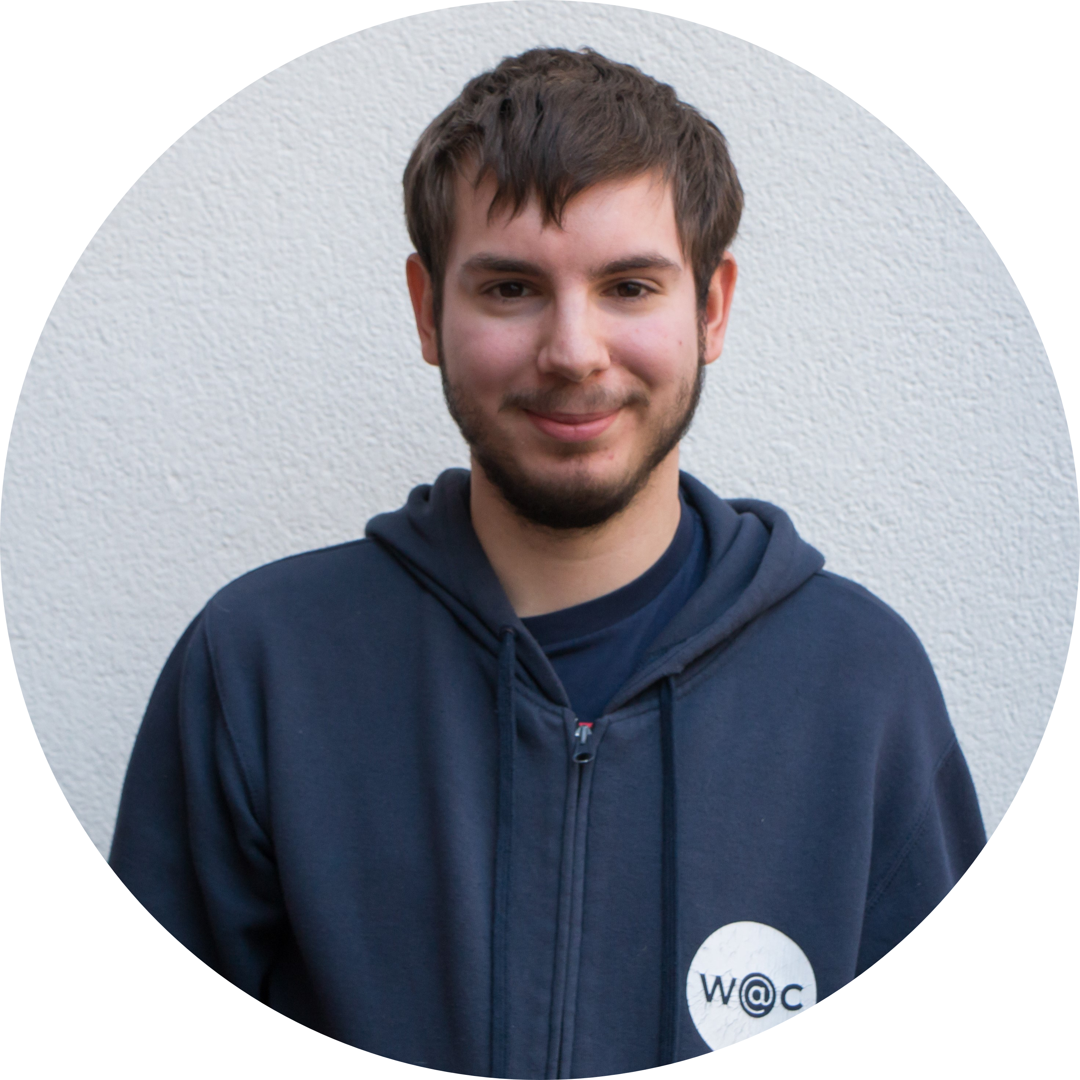
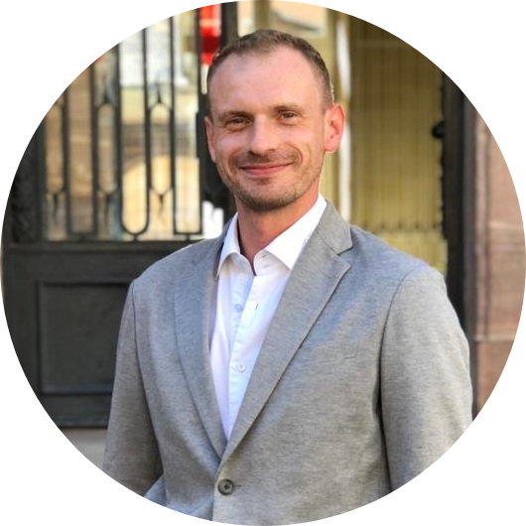
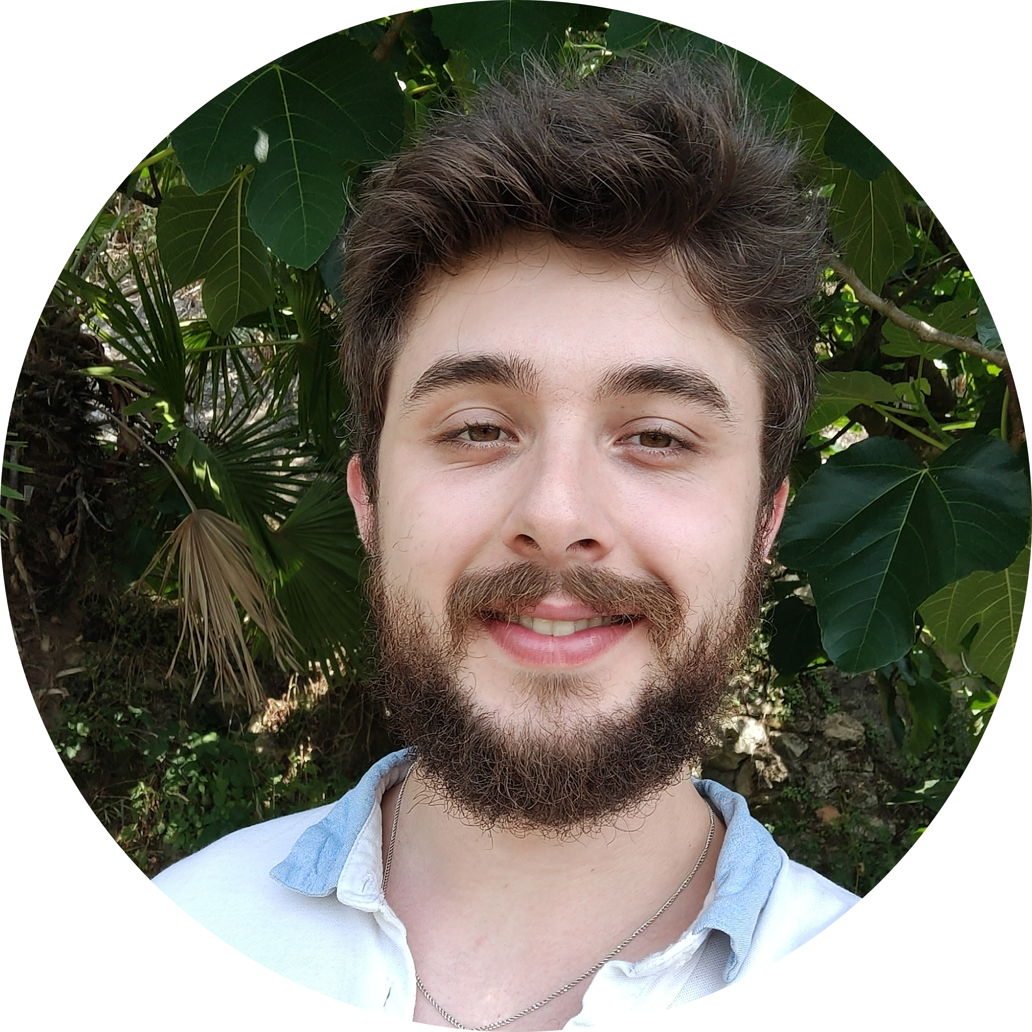
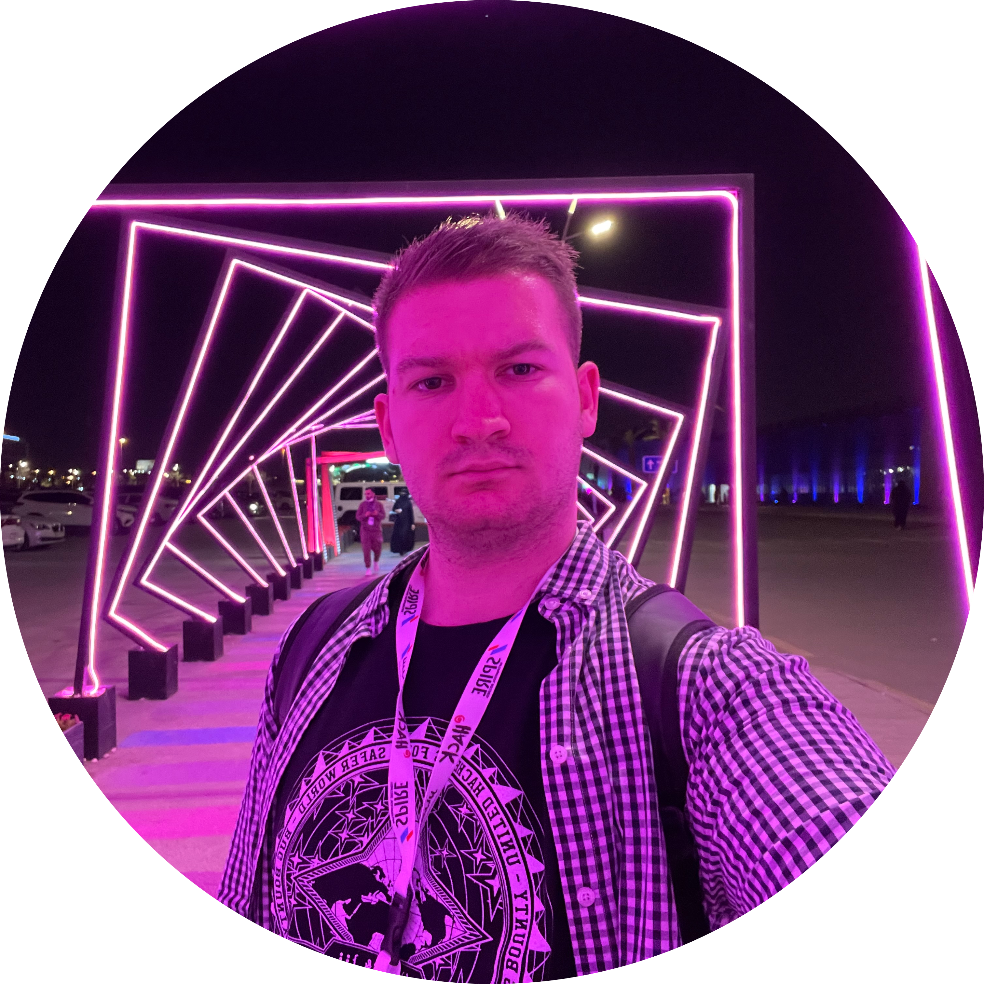
team
Pierre HARELLE
Jules BOZOUKLIAN
Maxime LARDIER
Quentin SOMMER
Grégory KOENIG
Notes:
jules

Slide 5





organization
communication
Notes:
pierre

Slide 6




organization
technology
Notes:
pierre

Slide 7
Project
Dockerfile
Docker compose
Environement
Docker hub
Push images
Backend
Frontend
Indexer
Elasticsearch
Rabbit
Port / network
Reporting
mysql
docker
Notes:
quentin

Slide 8
Project
KurbeRNETES
Notes:
max

Slide 9
feedback
Docker
Kubernetes
Time management with multiple projects
Lack of theoretical knowledge
Notes:
quentin

Slide 10
enhancements
Create a CI/CD pipeline
Improve DX on local env
Optimize code and processes
Harden security

Slide 11

Demonstration

Slide 12

questions
Notes:
jules

Slide 13

Thanks for your attention

